Slide 1

Net4j Signalling Platform
3.0 Release Review
Eike Stepper
stepper@esc-net.de
http://www.esc-net.de
http://thegordian.blogspot.com
Berlin, Germany

Slide 2
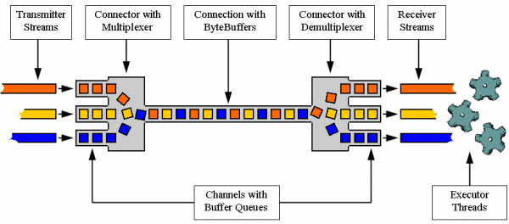
Introduction
The Net4j Signalling platform is an extensible client/server communications framework. Net4j eases the development of fast and maintainable application protocols that are independent of the physical transport medium. Transport protocols are pluggable and Net4j ships with support for TCP, HTTP and in-memory transport. The core of Net4j is a fast, asynchronous and non-blocking buffer multiplexing kernel, based on OSGi but also executable stand-alone.
Project URL:
http://wiki.eclipse.org/Net4j

Slide 3
Major New Features in 3.0
New signal hooks for load measurement
New protocol hooks for signal lifecycle
New features:
18 total

Slide 4
Other Release Highlights
Quality of APIs
  3.0 API is partly incompatible with 2.0
  API Toling has been used consequently
End of Life
  None
IP
  IP Log URL: http://www.eclipse.org/projects/ip_log.php?projectid=modeling.emf.net4j
  No issues
Committer Diversity
  9 committers from 9 different companies
  Several additions to the team are pending

Slide 5
Project Activity Since 1.0
Bugzilla
  6 of 18 enhancements done (12 left open)
  7 of 7 bugs fixed (none left open)
CVS
  3199 commits
Communication
  37 newsgroup posts

Slide 6
Schedule
Helios
  All release train schedules were met
  Continuous integration builds on Hudson
Plan URL
  http://www.eclipse.org/projects/project-plan.php?planurl=http://www.eclipse.org/modeling/emf/net4j/project-info/plan.xml&component=Net4j+Signalling+Platform

